Slide 1

Course Teacher: Prof. Dr. Israt Jahan

Slide 2
Computer Basics
Computer is an electronic machine that stores, retrieves and processes data.
Performs computations and makes logical decisions
It cannot think or reason
It can only carry out instructions given to it
Millions / billions times faster than human beings

Slide 3

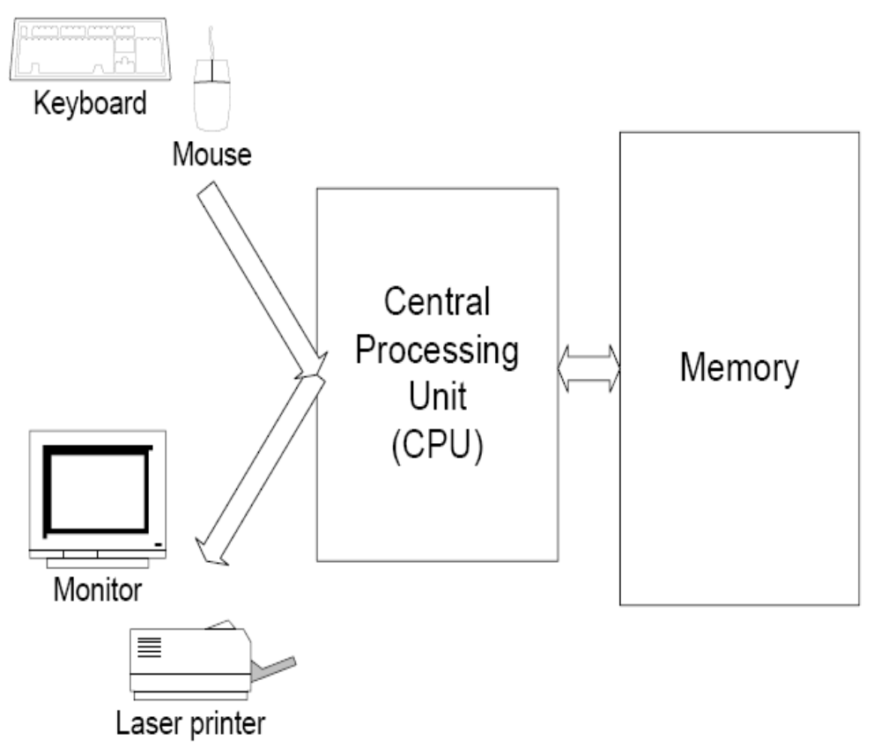

Slide 4
Work flow of Computer
Input
Processing
Output
Input data from disk, keyboard or other storage media
Process data
Output results to display screen, disk or other media

Slide 5
Programming Languages
Computer programs
      Sets of instructions which directs a computer to perform certain function.
Types:
Machine language
Assembly language
High-level languages

Slide 6
Machine language
Binary
Machine dependent
Stored in the computer when the program is running
A CPU can only execute machine language instructions - computer’s language
Example:
  01110110001010010010 ….

Slide 7
Assembly language
Symbolic addressing, i.e.,
  Use Symbolic names to represent operations, registers and memory locations.
One-to-one correspondence with machine language
A program written in assembly language must be converted to machine language before the CPU can execute it.
A program called the assembler translates each assembly language statement into single machine language instruction.

Slide 8
Example:
  MOV AX, A
  ADD AX, 4
  STORE Z

Slide 9
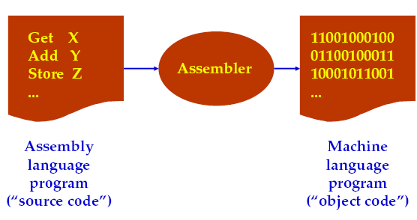
Automatically translating assembly language to machine language

Slide 10
High-level languages
Closer to how people think about their problems
No one-to-one correspondence to machine language
General purpose
Example:
  Z = A+ 4

Slide 11
High-level languages
Fortran
Basic
Visual Basic
C
C++
Java

Slide 12
Advantages of Assembly languages
Efficient
  It is so close to machine language.
  Produces a faster, shorter machine language program.
Some operations, such as reading or writing to specific memory locations and I/O ports can be done easily in assembly language but may be impossible at a higher level.
It also provides the way to realize how the computer “thinks” and performs the inner operations.

Slide 13
Computer Hardware Organization
CPU
Registers
RAM | ROM
program
data
storage
storage
Control, data, address bus
ALU
Control
unit
output
input
unit
unit

Slide 14
Registers
Information inside the microprocessor is stored in registers.
Even though the processor can operate on data stored in memory, the same instruction is faster if the data are stored in registers.

Slide 15
Types
Registers are classified into three categories according to the functions they perform. Each register is 16 bit.
  Data registers
      Hold data for an operation
  Address registers
      Hold the address of an instruction and data
  Status registers
      Keep the current status of the processor

Slide 16
Data Registers
8086 has four data registers for general data manipulation. They are:
  AX (Accumulator Register)
  BX (Base Register)
  CX ( Count Register )
  DX (Data Register)
The high and low bytes of the data registers can be accessed separately. The high byte of AX is called AH and the low byte is AL.

Slide 17
Data Registers
AX (Accumulator Register….AH+AL)
  Use in arithmetic, logic and data transfer instructions because its use generates the shortest machine code.
  In multiplication and division operations, one of the numbers involved must be in AX or AL.
BX (Base Register…..BH+BL)
  Serves as an address register

Slide 18
Data Registers
CX (Count Register……CH+CL)
  Use in program loop constructions….serves as loop counter
  Use in REP (repeat), string operations, shift and rotate operations.
DX (Data Register…..DH+DL)
  Use in multiplication and division
  Use in I/O operations

Slide 19
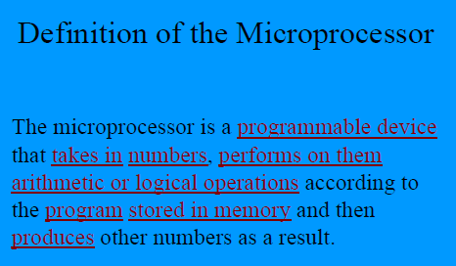

Slide 20
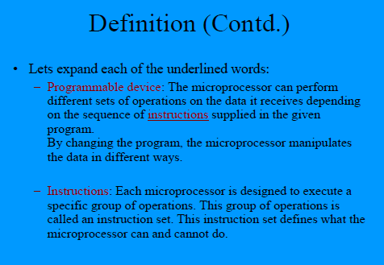

Slide 21
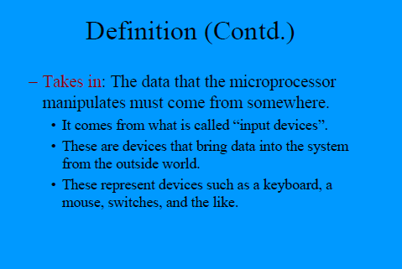

Slide 22
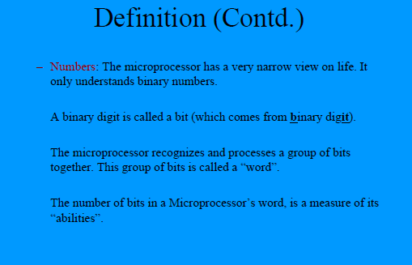

Slide 23
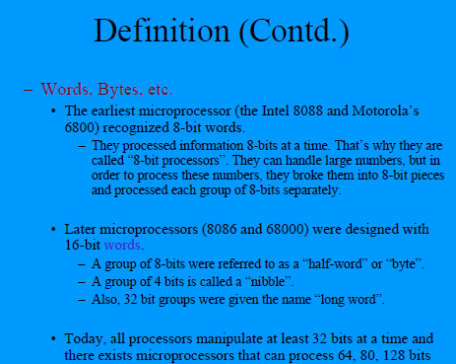

Slide 24
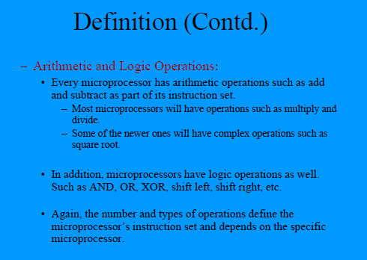

Slide 25
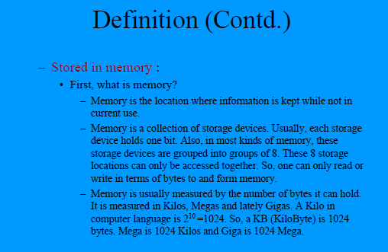

Slide 26
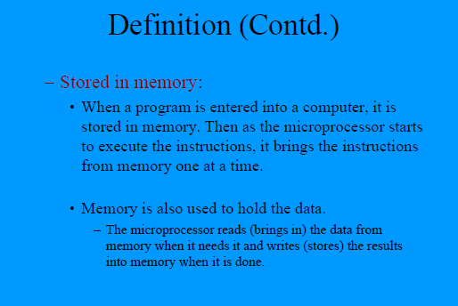

Slide 27
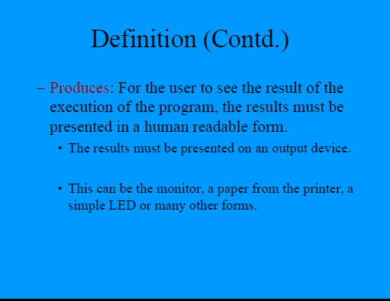

Slide 28
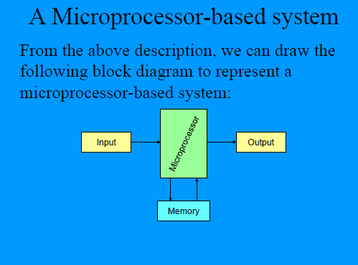

Slide 29
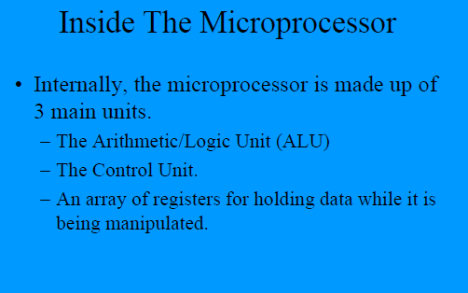

Slide 30
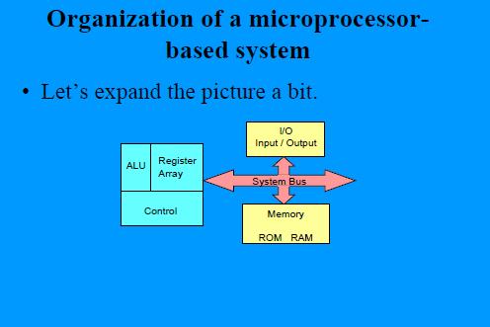

Slide 31
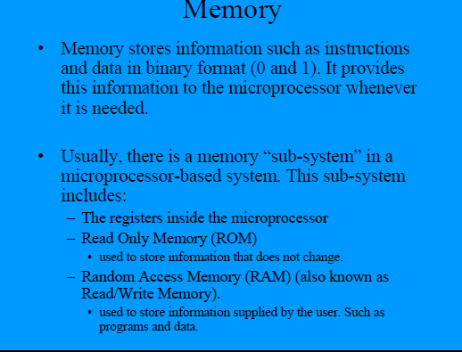

Slide 32
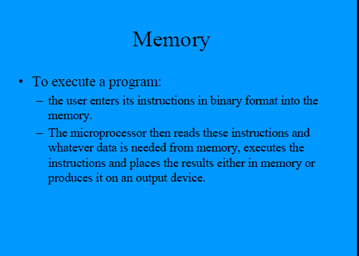

Slide 33
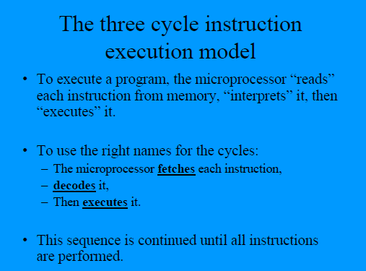

Slide 34
Basic element of a computer are
CPU
Memory
Input/Output (I/O) units.
CPU | Translates | instructions
 | Perform | arithmetic of logic operations
 | Temporarily stores | instructions & data in its internal high-speed registers

Slide 35
Memory : Stores Program & Data
I/O Unit : Interfaces the computer with external device such as Keyboard and Display.
With the advent of semiconductor technology, it is possible to integrate CPU in a chip.
Result : Microprocessor
Technology : MOS (both by Intel & Motorola)
Single chip microcomputers are also available in which microprocessors, memory and I/O are all fabricated the same chip. (limited capabilitis ideal for peripheral controllers)

Slide 36
Single Chip microcomputers Microcontrollers
Microcontrollers
Automotive systems,
home entertainment system.
Evolution of the Microprocessor
Intel corporation introduced 1st Microprocessor
4004 (4bit) in 1971.
The 4004 evolved from a development effort while
designing a Calculator Chip set.
Soon after 4004 appeared Commercially, 3 other
microprocessors use introduced

Slide 37
Rockwell International Intel 8 bit 8008 &
National Semiconductor 16 bit Imp-16.
Microprocessor between 1971 and 1973 :
1st Generation system Designed with PMOS technology.
This technology provides
Low cost
Slow Speed
Low input current &
Was not compatible with TTL

Slide 38
After 1973, 2nd Generation Microprocessor such as,
MOS technology 6502
Motorola 6800 & 6809
Intel 8085 & Zilog Z80 evolved
There 8 bit processors were fabricated using NMOS
technology.
NMOS process offers faster speed and higher density
than PMOS & is TTL-Compatible.
After 1978, the 3rd Generation microprocessors were
introduced.
These processors are 16 bits wide (16 bit ALU) &
include: Intel 8086/80186/80286 &
Motorola 68000/68010
Technology : HMOS (High Density MOS)

Slide 39
HMOS provides the following advantages over NMOS
Speed-Power-Product (SPP) is 4 times better than NMOS
Circuit densities provided by HMOS are approximately twice than of NMOS.
Later, Intel utilized the HMOS technology to fabricate 8085A. High Speed Version of 8085 A is 8085 AH.

Slide 40
In 1980, 4th generation microprocessors are evolved.
Intel introduced the first commercial 32 bit microprocessor the problematic Intel 432. This Processor was eventually discontinued by Intel.
Since 1985, mouse 32 bit microprocessors have been introduced. These include:
Motorola’s MC 68020/68030/68040
Intel’s 80386/804486
Intel Pentium processors.

Slide 41
These processors are fabricated using Low-power version of the HMOS technology called the HCMOS.
The performance offered by the 32 bit processor is make comparable to that of superminicomputers such as DEC’s VAX 11/750 & VAX 11/780.
Both Intel & Motorola introduced 32 bit RISC processor (Intel 80960 & Motorola MC88100/PowerPC) with simplified instruction sets.

Slide 42
Purpose of RISC processors : Maximize speed by reducing clock cycles per instruction.
RISC microprocessor have hardwired instructions sets like non RISC microprocessor (Such as Intel 8085 & MOS 6502).
This means that for every instruction, there exist actual, Physical connections that provide the desired instruction decoding.
The microprocessor, therefore does not use valuable clock cycle (machine cycle) in instruction decoding.

Slide 43
Since RISC type microprocessor are hardwired, instructions may be executed simultaneously (as long as instruction do not share the same register).
This technique is pipelining.
The processor continues to fetch instructions even though it has not executed the present instructions.
At this stage, the instructions are intelligently fed into the instructing execution unit.
Registers are checked whether second instruction can be executed.

Slide 44
The RISC microprocessor can execute as any as 5
instruction simultaneously.
The trend in microprocessor is implementation of more
on-chip functions and for improvement of the speeds
of memory and I/O devices.

Slide 45
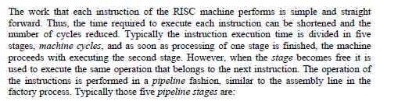

Slide 46
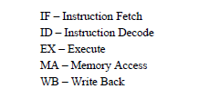

Slide 47
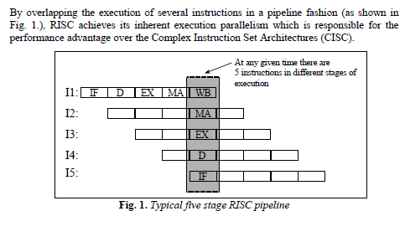

Slide 48


Slide 49
Overview
Pipelining is widely used in modern processors.
Pipelining improves system performance in terms of throughput.
Pipelined organization requires sophisticated compilation techniques.

Slide 50
Making the Execution of Programs Faster
Use faster circuit technology to build the processor and the main memory.
Arrange the hardware so that more than one operation can be performed at the same time.
In the latter way, the number of operations performed per second is increased .

Slide 51
Traditional Pipeline Concept
Laundry Example
Ann, Brian, Cathy, Dave
each have one load of clothes
to wash, dry, and fold
Washer takes 30 minutes
Dryer takes 40 minutes
“Folder” takes 20 minutes
A
B
C
D

Slide 52
Traditional Pipeline Concept
6 PM
7
8
9
10
11
Midnight
Time
30
40
20
30
40
20
30
40
20
30
40
20
Sequential laundry takes 6 hours for 4 loads
If they learned pipelining, how long would laundry take?
A
B
C
D

Slide 53
Traditional Pipeline Concept
6 PM
7
8
9
10
11
Midnight
T
a
s
k
O
r
d
e
r
Time
30
40
40
40
40
20
A
Pipelined laundry takes 3.5 hours for 4 loads
B
C
D

Slide 54
What is Pipelining
A technique used in advanced microprocessors where the microprocessor begins executing a second instruction before the first has been completed.
A Pipeline is a series of stages, where some work is done at each stage. The work is not finished until it has passed through all stages.
With pipelining, the computer architecture allows the next instructions to be fetched while the processor is performing arithmetic operations, holding them in a buffer close to the processor until each instruction operation can performed.

Slide 55
How Pipelines Works
The pipeline is divided into segments and each segment can execute it operation concurrently with the other segments. Once a segment completes an operations, it passes the result to the next segment in the pipeline and fetches the next operations from the preceding segment.

Slide 56
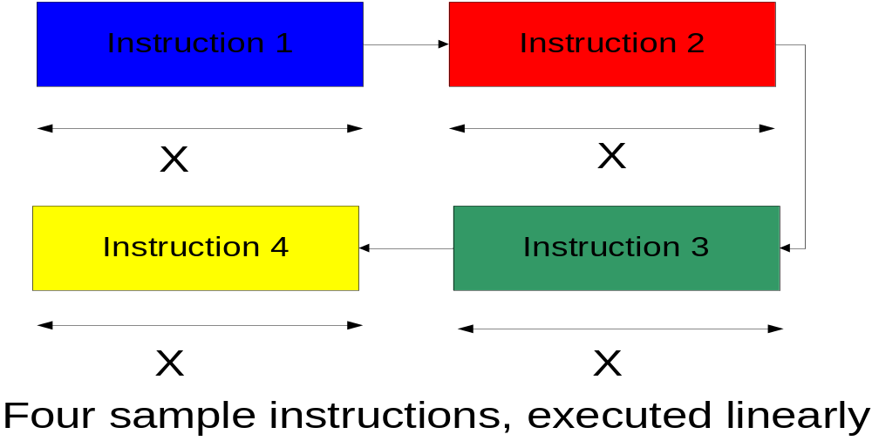
Example

Slide 57
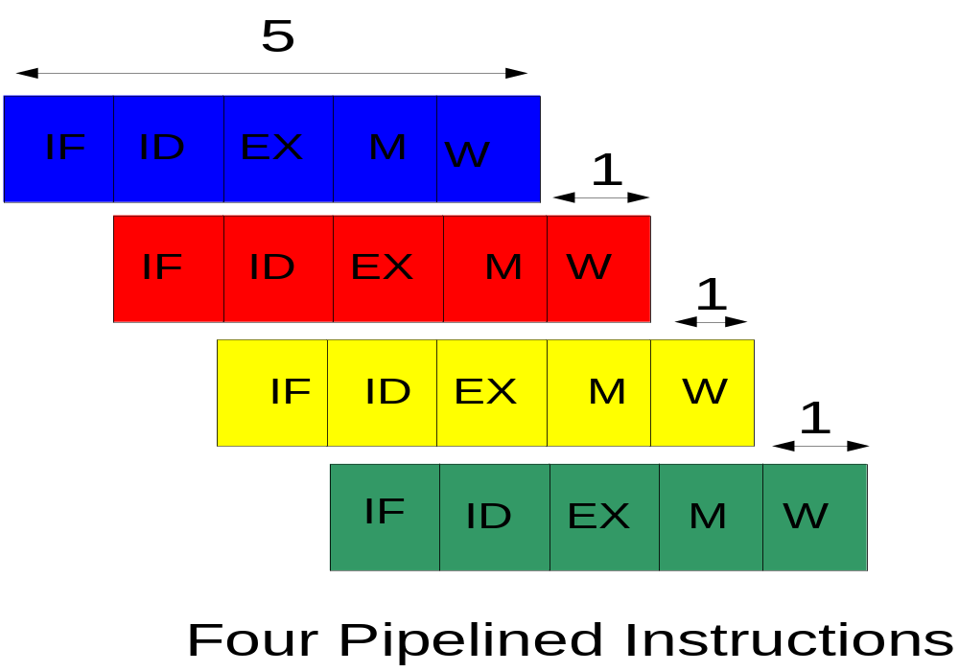

Slide 58
Instructions Fetch
The instruction Fetch (IF) stage is responsible for obtaining the requested instruction from memory. The instruction and the program counter (which is incremented to the next instruction) are stored in the IF/ID pipeline register as temporary storage so that may be used in the next stage at the start of the next clock cycle.

Slide 59
Instruction Decode
The Instruction Decode (ID) stage is responsible for decoding the instruction and sending out the various control lines to the other parts of the processor. The instruction is sent to the control unit where it is decoded and the registers are fetched from the register file.

Slide 60
Execution
The Execution (EX) stage is where any calculations are performed. The main component in this stage is the ALU. The ALU is made up of arithmetic, logic and capabilities.

Slide 61
Memory and IO
The Memory and IO (MEM) stage is responsible for storing and loading values to and from memory. It also responsible for input or output from the processor

Slide 62
Write Back
The Write Back (WB) stage is responsible for writing the result of a calculation, memory access or input into the register file.

